Slide 1
Scalable, NUMA-Aware Shared-Memory Data Structures
CS550 – Advanced Operating Systems
Bo Huang, Qiming Lyu

Slide 2
Background
WHAT’S NUMA
NUMA (NON-UNIFORM MEMORY ACCESS) IS THE PHENOMENON THAT MEMORY AT VARIOUS POINTS IN THE ADDRESS SPACE OF A PROCESSOR HAS DIFFERENT PERFORMANCE CHARACTERISTICS
DIFF PERFORMANCE DUE TO NUMA
NUMA CAUSES BAD PERFORMANCE FOR SHARED-MEMORY DATA STRUCTURES SINCE DIFFERENT CPUS WILL HAVE SIGNIFICANTLY DIFFERENT LATENCIES TO THE SAME MEMORY REGION IF THEY ARE FROM DIFFERENT NODES.
CURRENT LIB DOES NOT CONSIDER
USING SHARED-MEMORY, BUT DO NOT CONSIDER THE NUMA EFFECTS SERIOUSLY INCLUDING NUMACTL, BOOST, BCL, HCL.
THE BOOST LIBRARY BECOMES ONE OF THE TR1 STANDARDS FOR C++

Slide 3
Target
Evaluate
Evaluate the impact of shared memory on performance
Evaluate
Evaluate the impact of NON-NUMA sensitive data structures on performance
Try
Try to make a NUMA-sensitive data structure to get better performance.

Slide 4
Environment for Experience
Chameleon Cloud
2 NUMA-Node, 16 CPUs
Ubuntu 20.04 (Linux version 5.4.0-139-generic)
Boost (libboost 1.71-dev amd64)
gcc (g++ (Ubuntu 9.4.0-1ubuntu1~20.04.1) 9.4.0)

Slide 5
Data-Structure Tested(Memory access)
Memory copy
Unorder_map
Unorder_set
Singly_linked_list
Lock_free_queue
Vector

Slide 6
STD vs Boost (Local) vs SHM (Local) vs Cross Node
Test parameters
the size of the data
element type
Frequency of insertion and deletion operations
run multiple times for stable results
Analyzing test results
Interpret and evaluate test results

Slide 7
STD (Local) Singly_linked_list

Slide 8
Boost (Local) Singly_linked_list

Slide 9
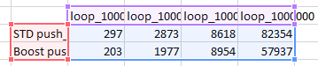
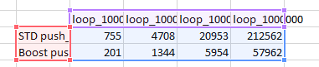
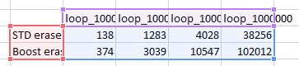
STD vs Boost (Local) Integer

Slide 10
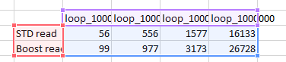
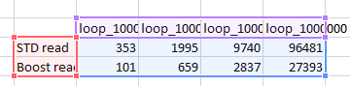
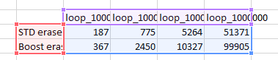
STD vs Boost (Local) 32Byte-Vec

Slide 11
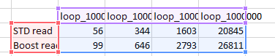
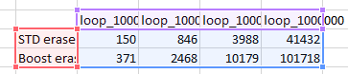
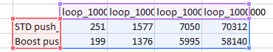
STD vs Boost (Local) Double

Slide 12
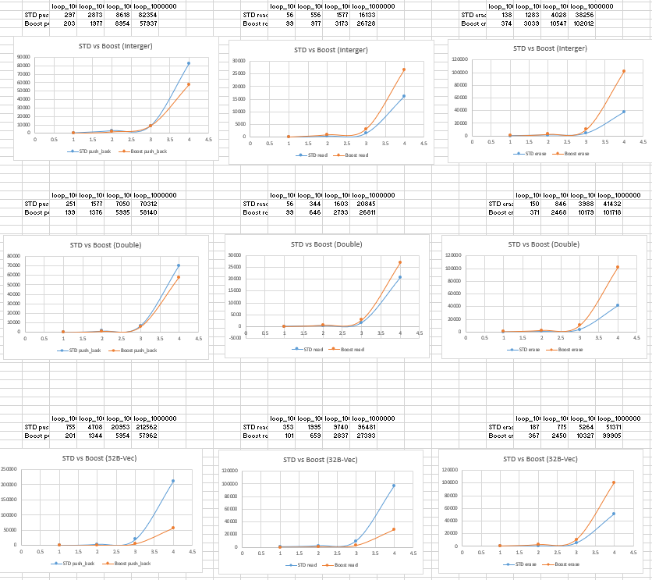
STD vs Boost (Local)- Concusion
Boost optimizes push_front and read operations (especially push_front)
The performance of Boost's Erase operation is much worse
When reading, STD is better in small data, and Boost is dominant in big data

Slide 13
Boost (Shared-Memory)

Slide 14
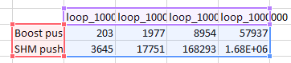
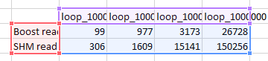
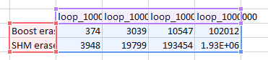
Boost vs SHM - Integer

Slide 15
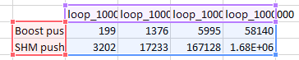
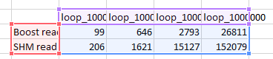
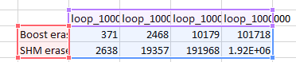
Boost vs SHM - Double

Slide 16
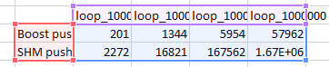
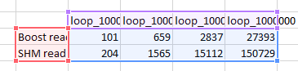
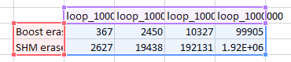
Boost vs SHM – 32B-Vec

Slide 17
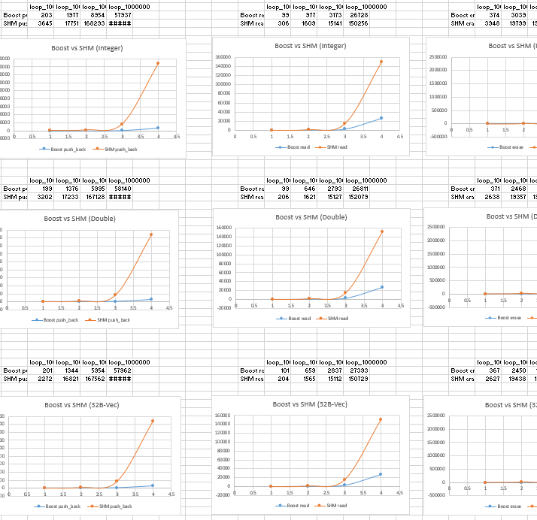
Boost vs SHM - Conclustion
Shared Memory has much more overhead

Slide 18
Cross Node Read (SHM)

Slide 19
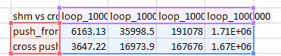
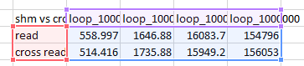
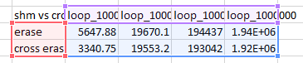
Local node vs Cross node

Slide 20
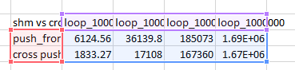
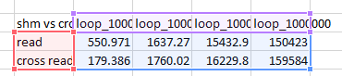
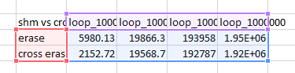
Local node vs Cross node

Slide 21
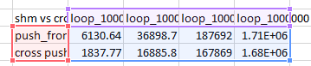
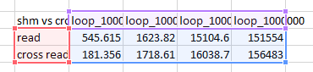
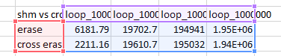
Local node vs Cross node

Slide 22
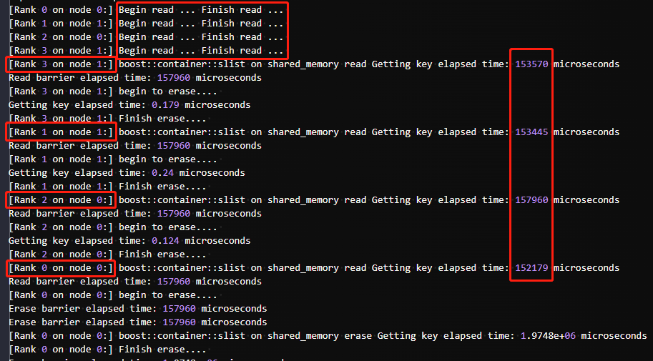
Cross Read test log

Slide 23
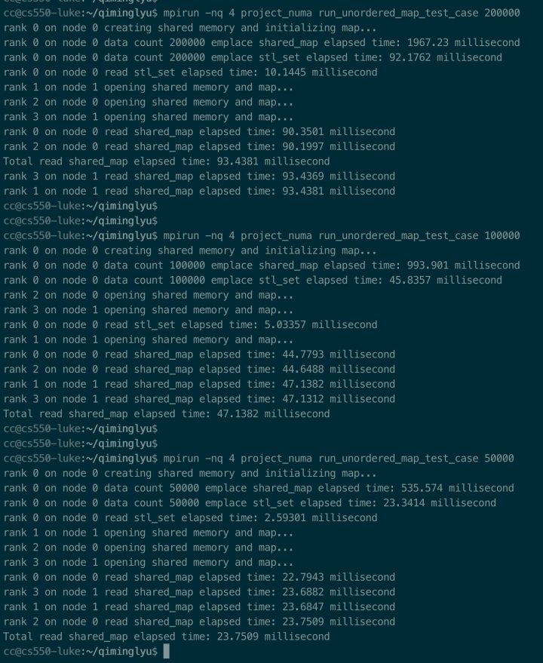
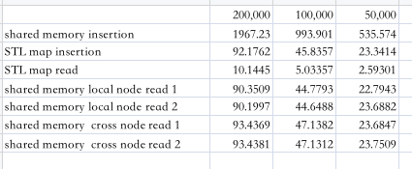
STD vs Boost
Unorder_map

Slide 24
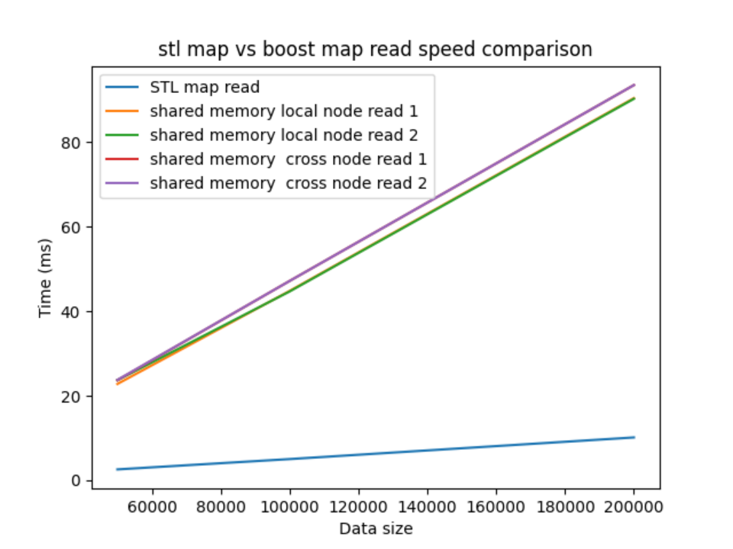
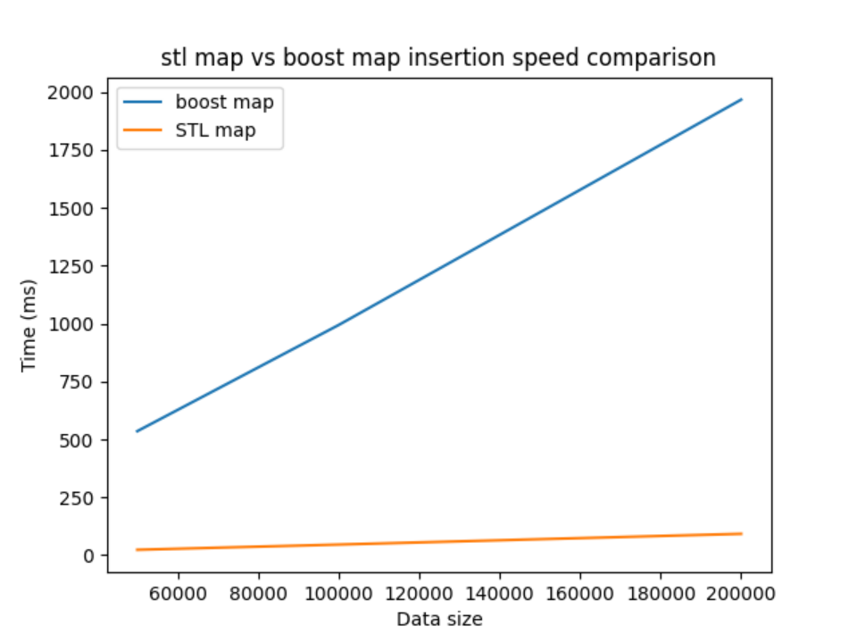
STD vs Boost
Unorder_map

Slide 25
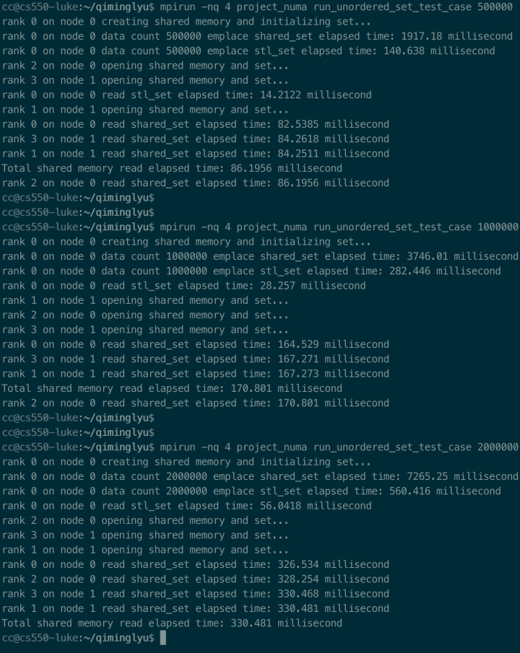
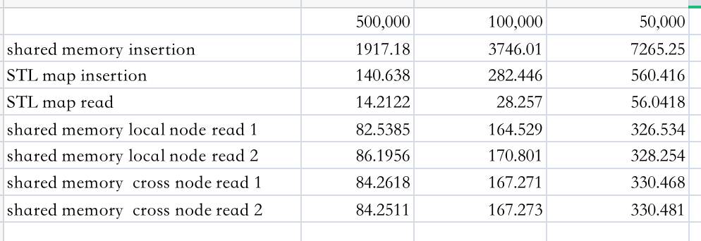
STD vs Boost
Unorder_set

Slide 26
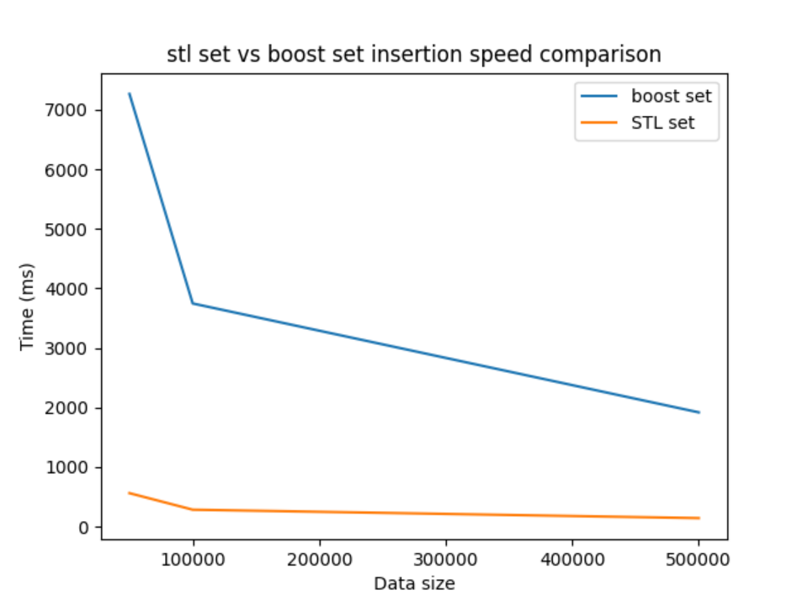
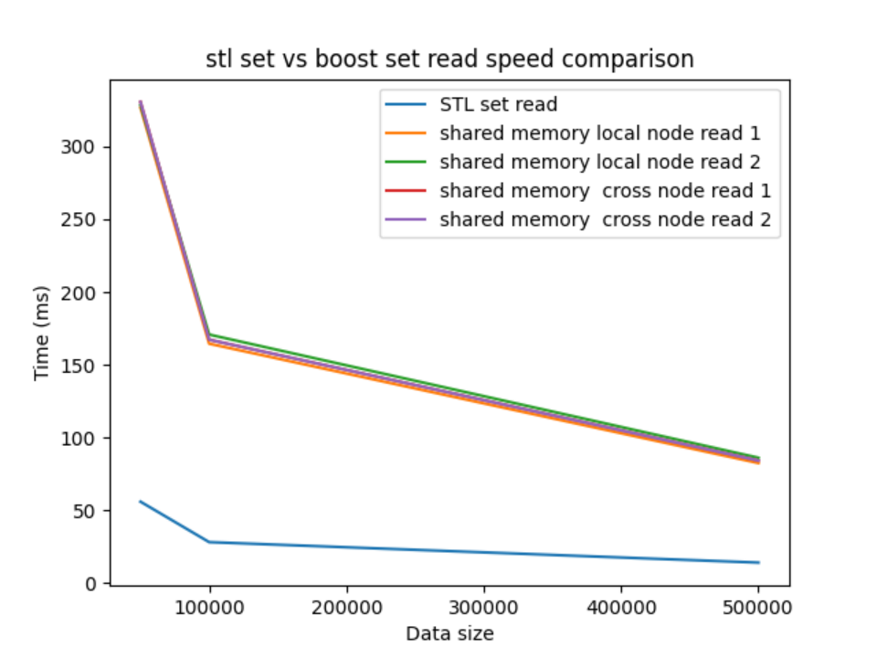
STD vs Boost
Unorder_set

Slide 27
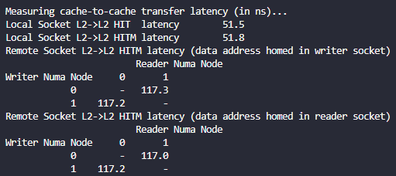
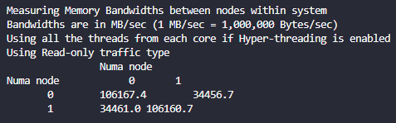
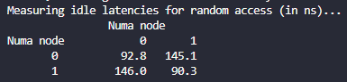
Intel® Memory Latency Checker

Slide 28
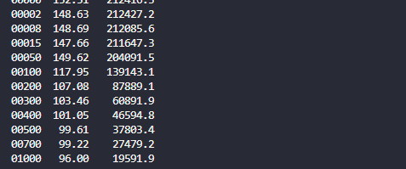
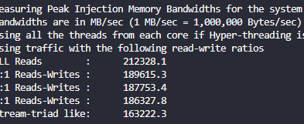
Intel® Memory Latency Checker

Slide 29
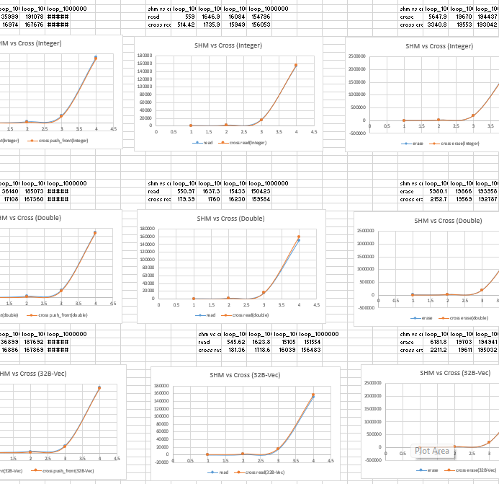
Conclusion
NUMA makes confused
NON-NUMA-Sensitive but almost same performance

Slide 30
What’s wrong?
Why we cannot see the NUMA effects
Cache?
Mutex?
Coding problem?
Continue to make experience to get more data
Find another way. (HCL, Other tools)

Slide 31

Thanks Logan
Give us examples and ideas
Help to debug
Very diligent
Always be humble

Slide 32
Thanks
This project was the funniest thing in the whole course.

